Slide 1


Project Trippy
Web Scraping Tripadvisor Hotel Listings

Slide 2

Objective
Compare Hotel Listings and associated marketing tags
Build a web crawler to pull tags/features from a variety of cities and compare with Priceline data
Try not to bore EVERYONE

Slide 3
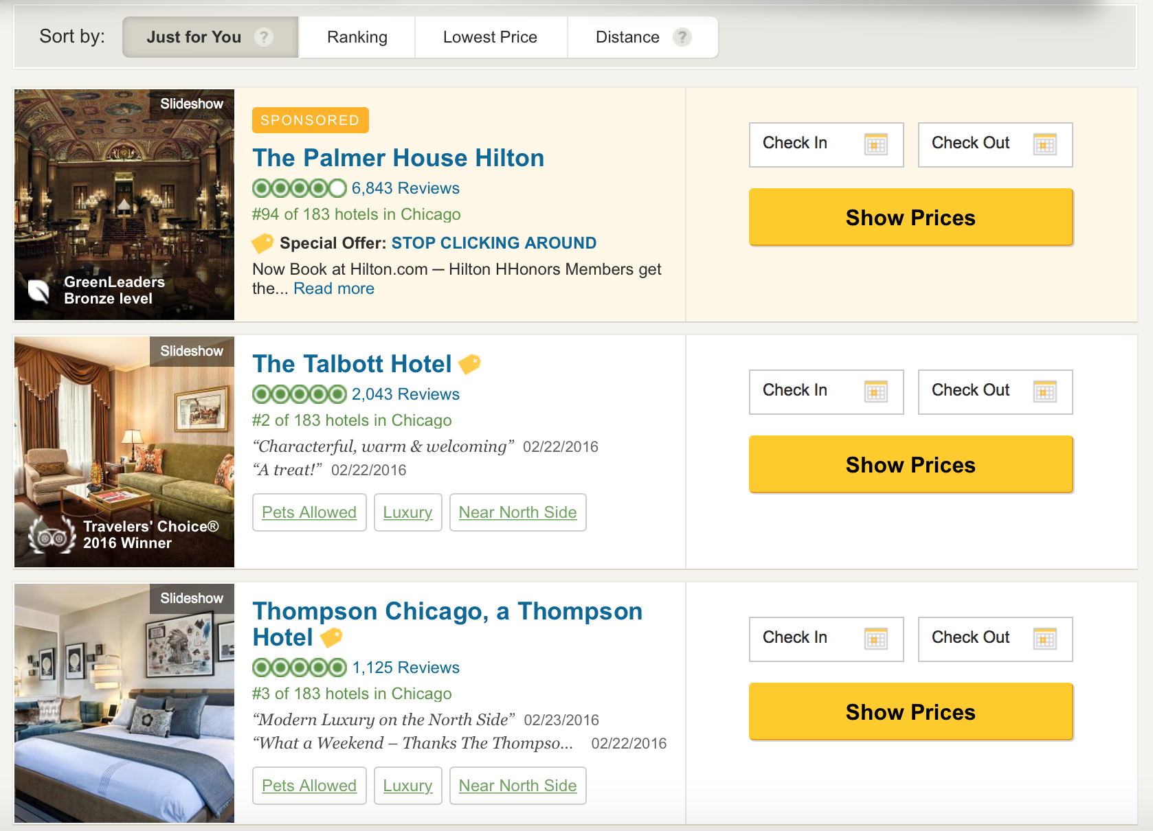
So, What are we Scrapping?
Hotel Name
City
State
Star Rating (1-5 stars)
Review Count
Feature Tags
City Ranking

Slide 4
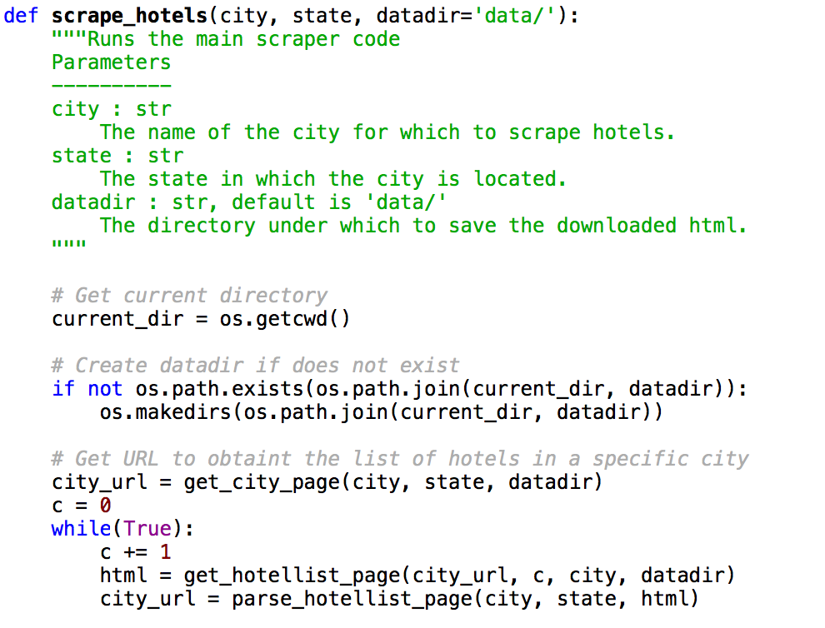
Scraping Algo
Built to accompany my Priceline Shiny app
Inputs: City, State, Directory
The base code was taken from the GitHub account for Boston University’s Data Mining course
https://github.com/dataminingapp/dataminingapp-lectures

Slide 5
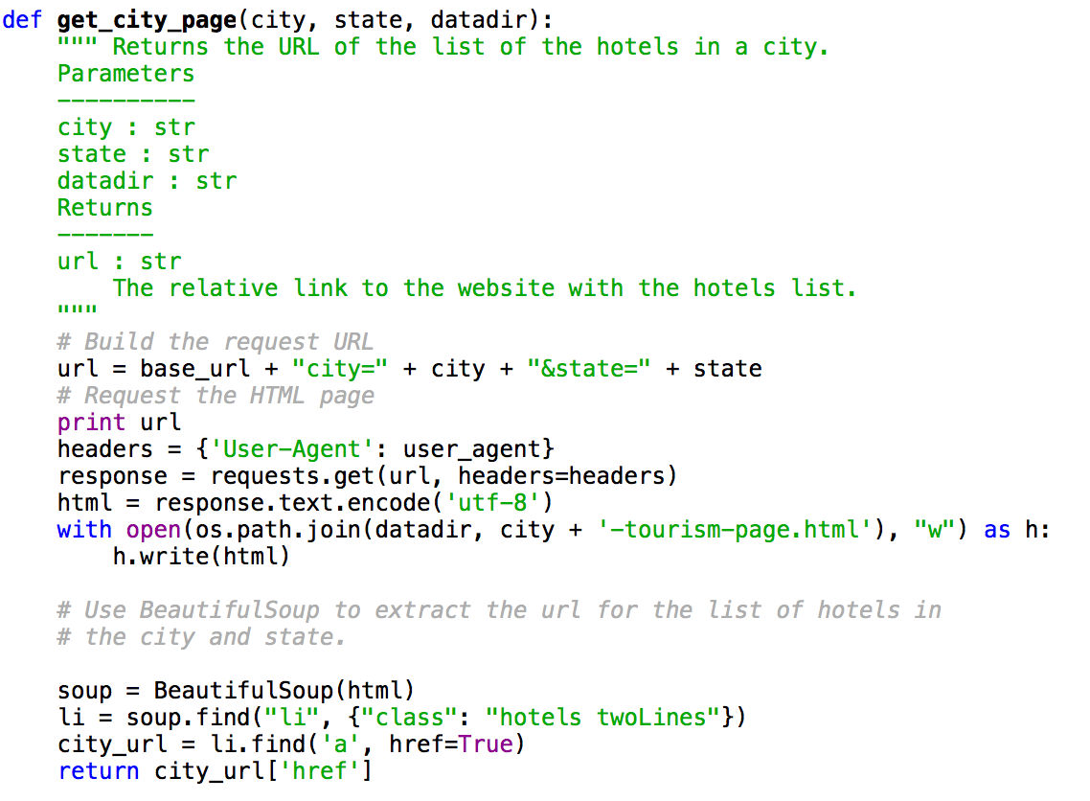
Get the City URL

Slide 6
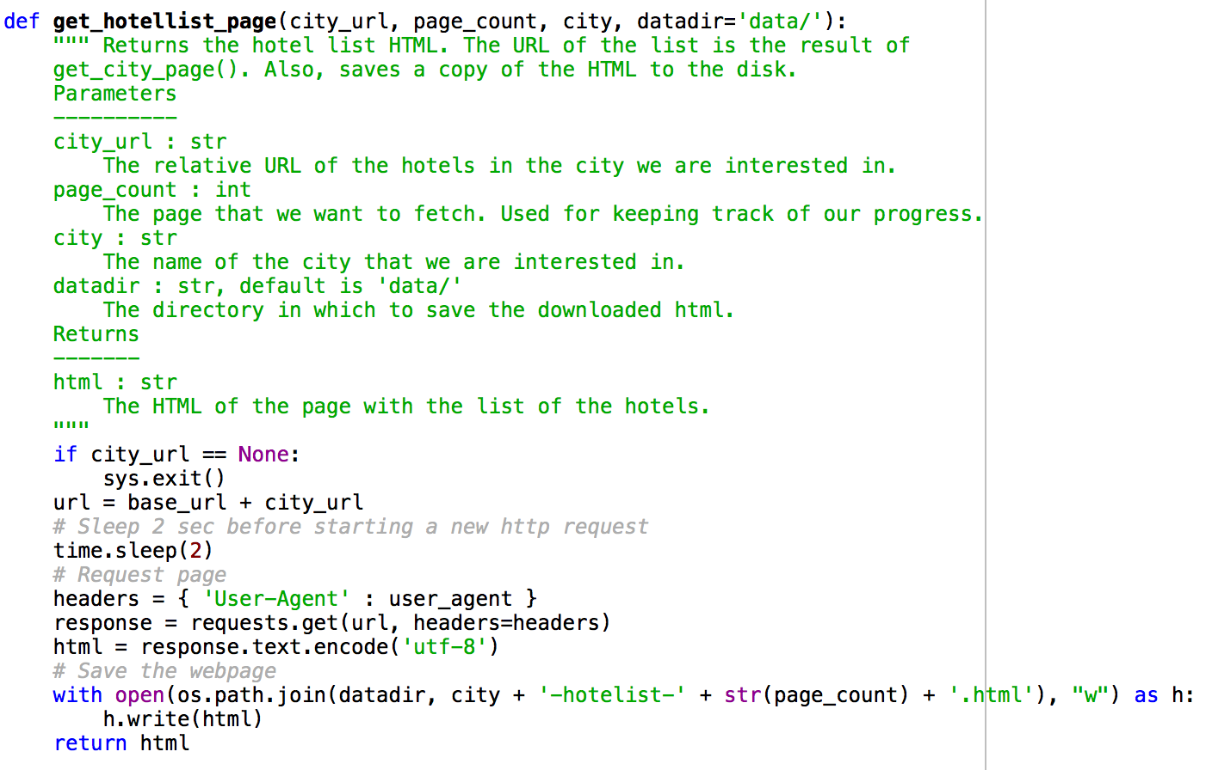
Get the URL and Page Count

Slide 7
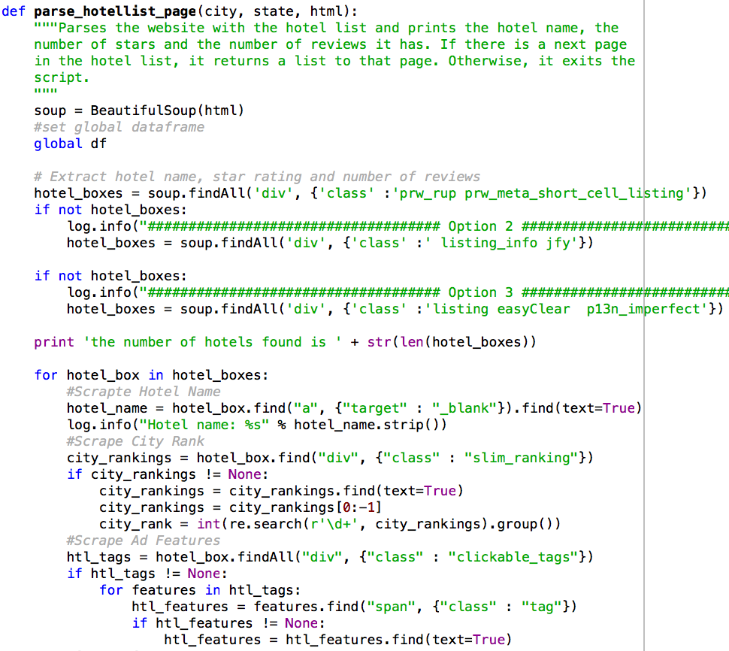
Scrape!

Slide 8
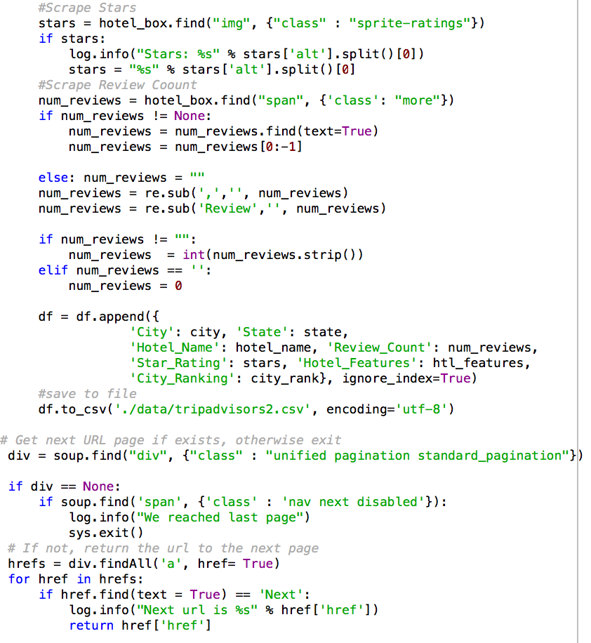
Scrape More!

Slide 9
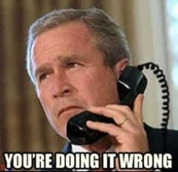
Success!........Almost
Running the Priceline list of cities and states from my ended up pulling huge amounts of errors and wrongs sites.
Only major cities that survived the list include:
NYC
Chicago
LA
Salt Lake City
So close……

Slide 10
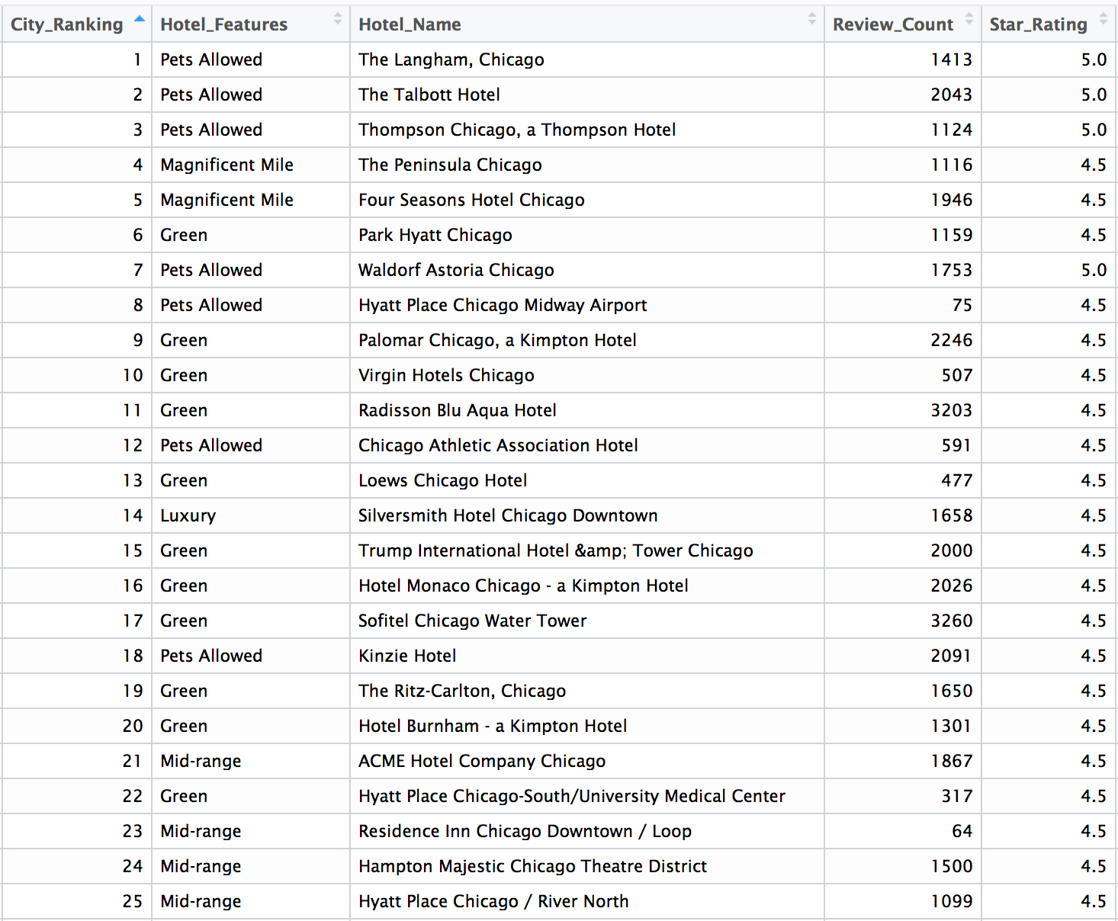

Slide 11
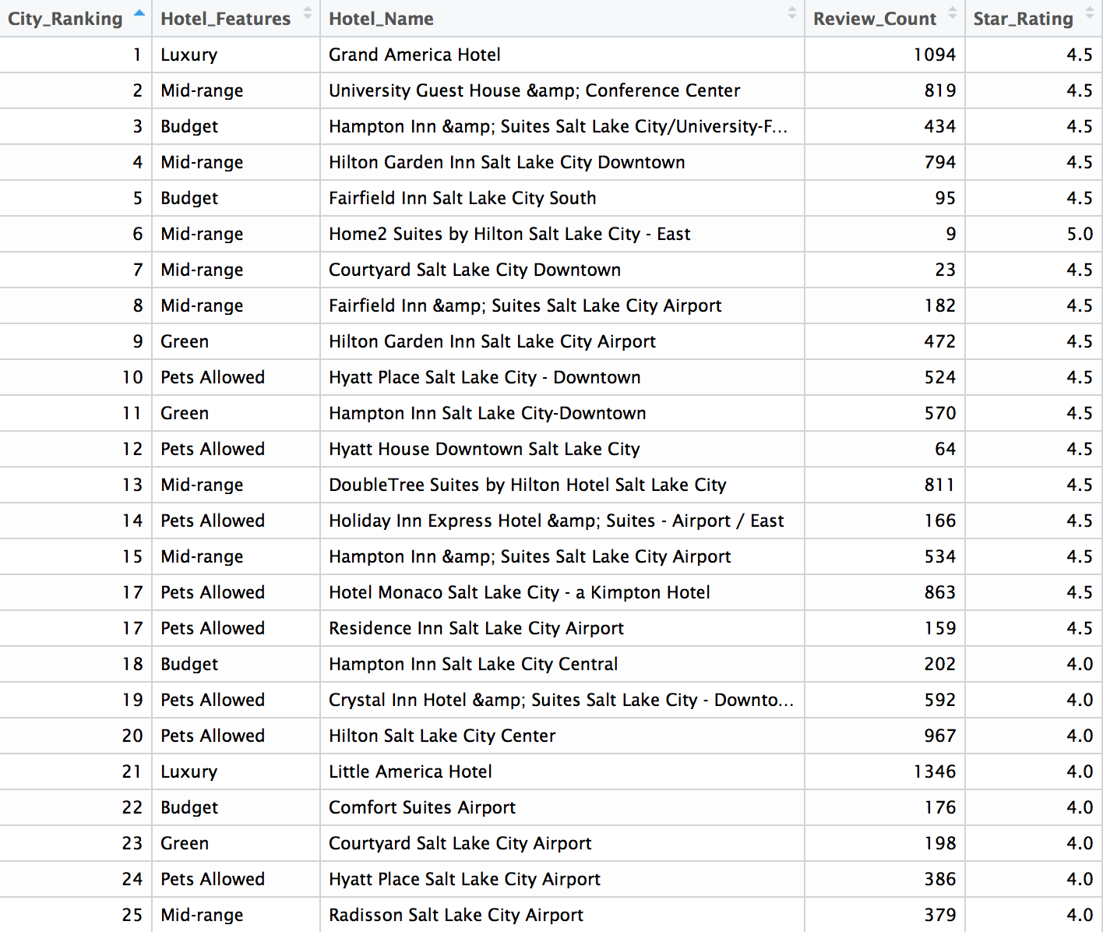

Slide 12
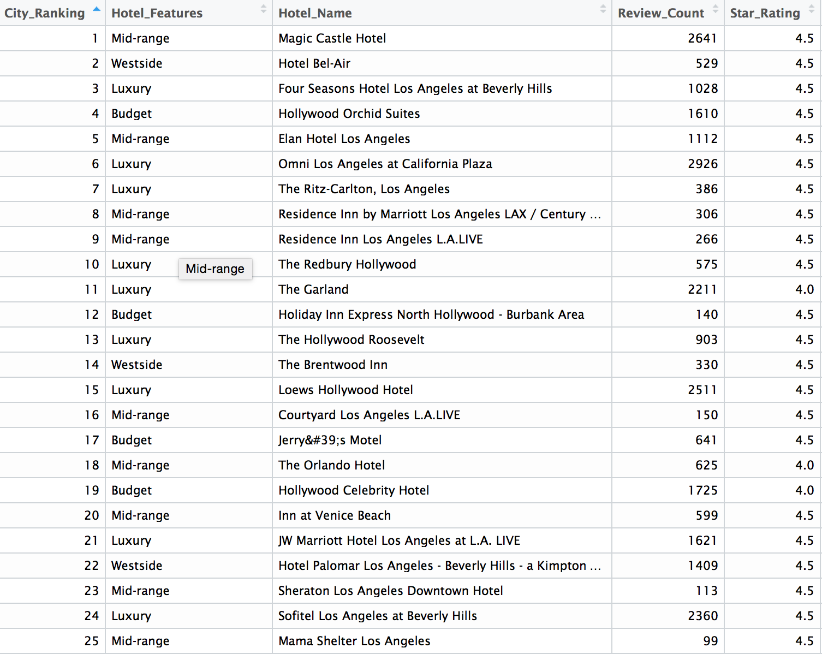

Slide 13
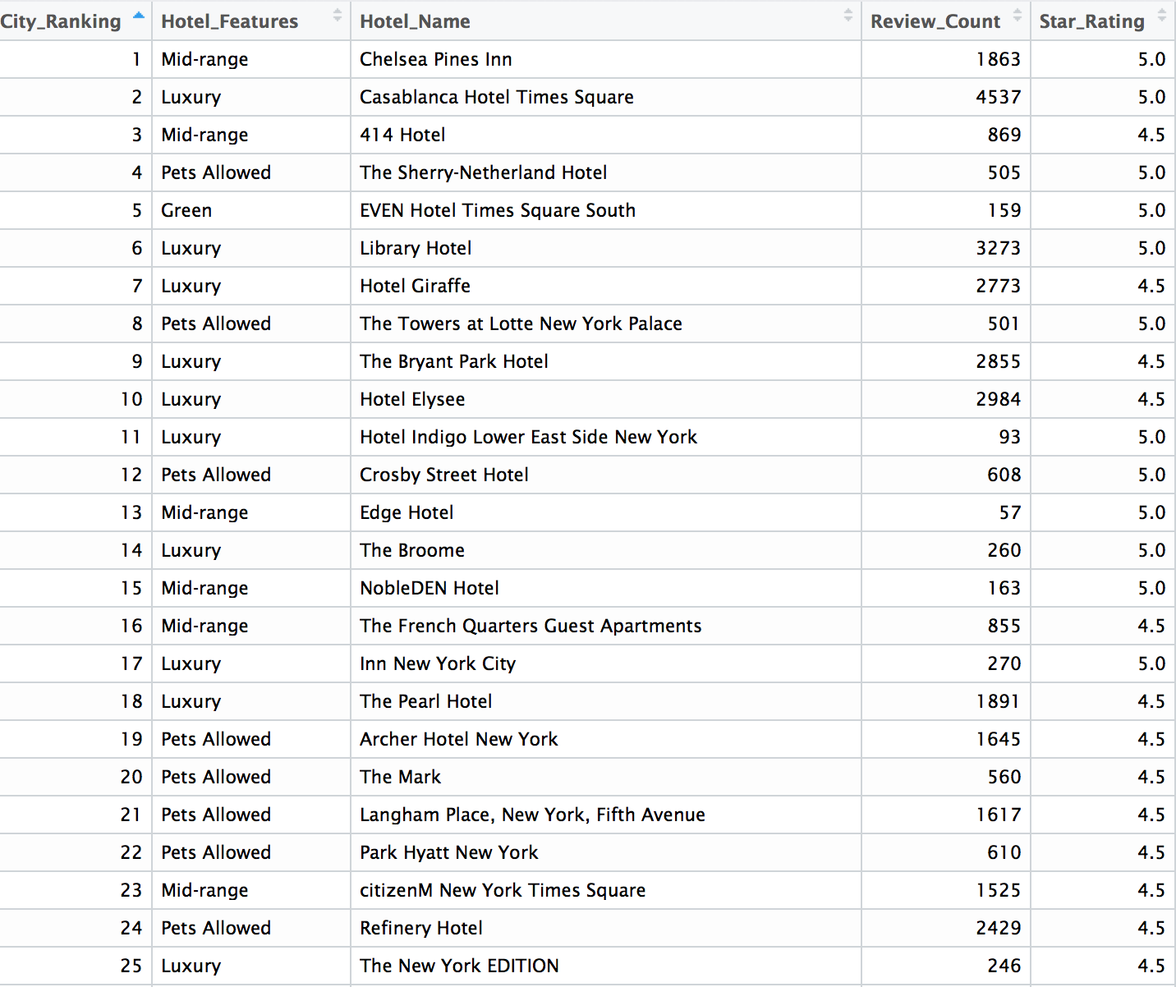

Slide 14
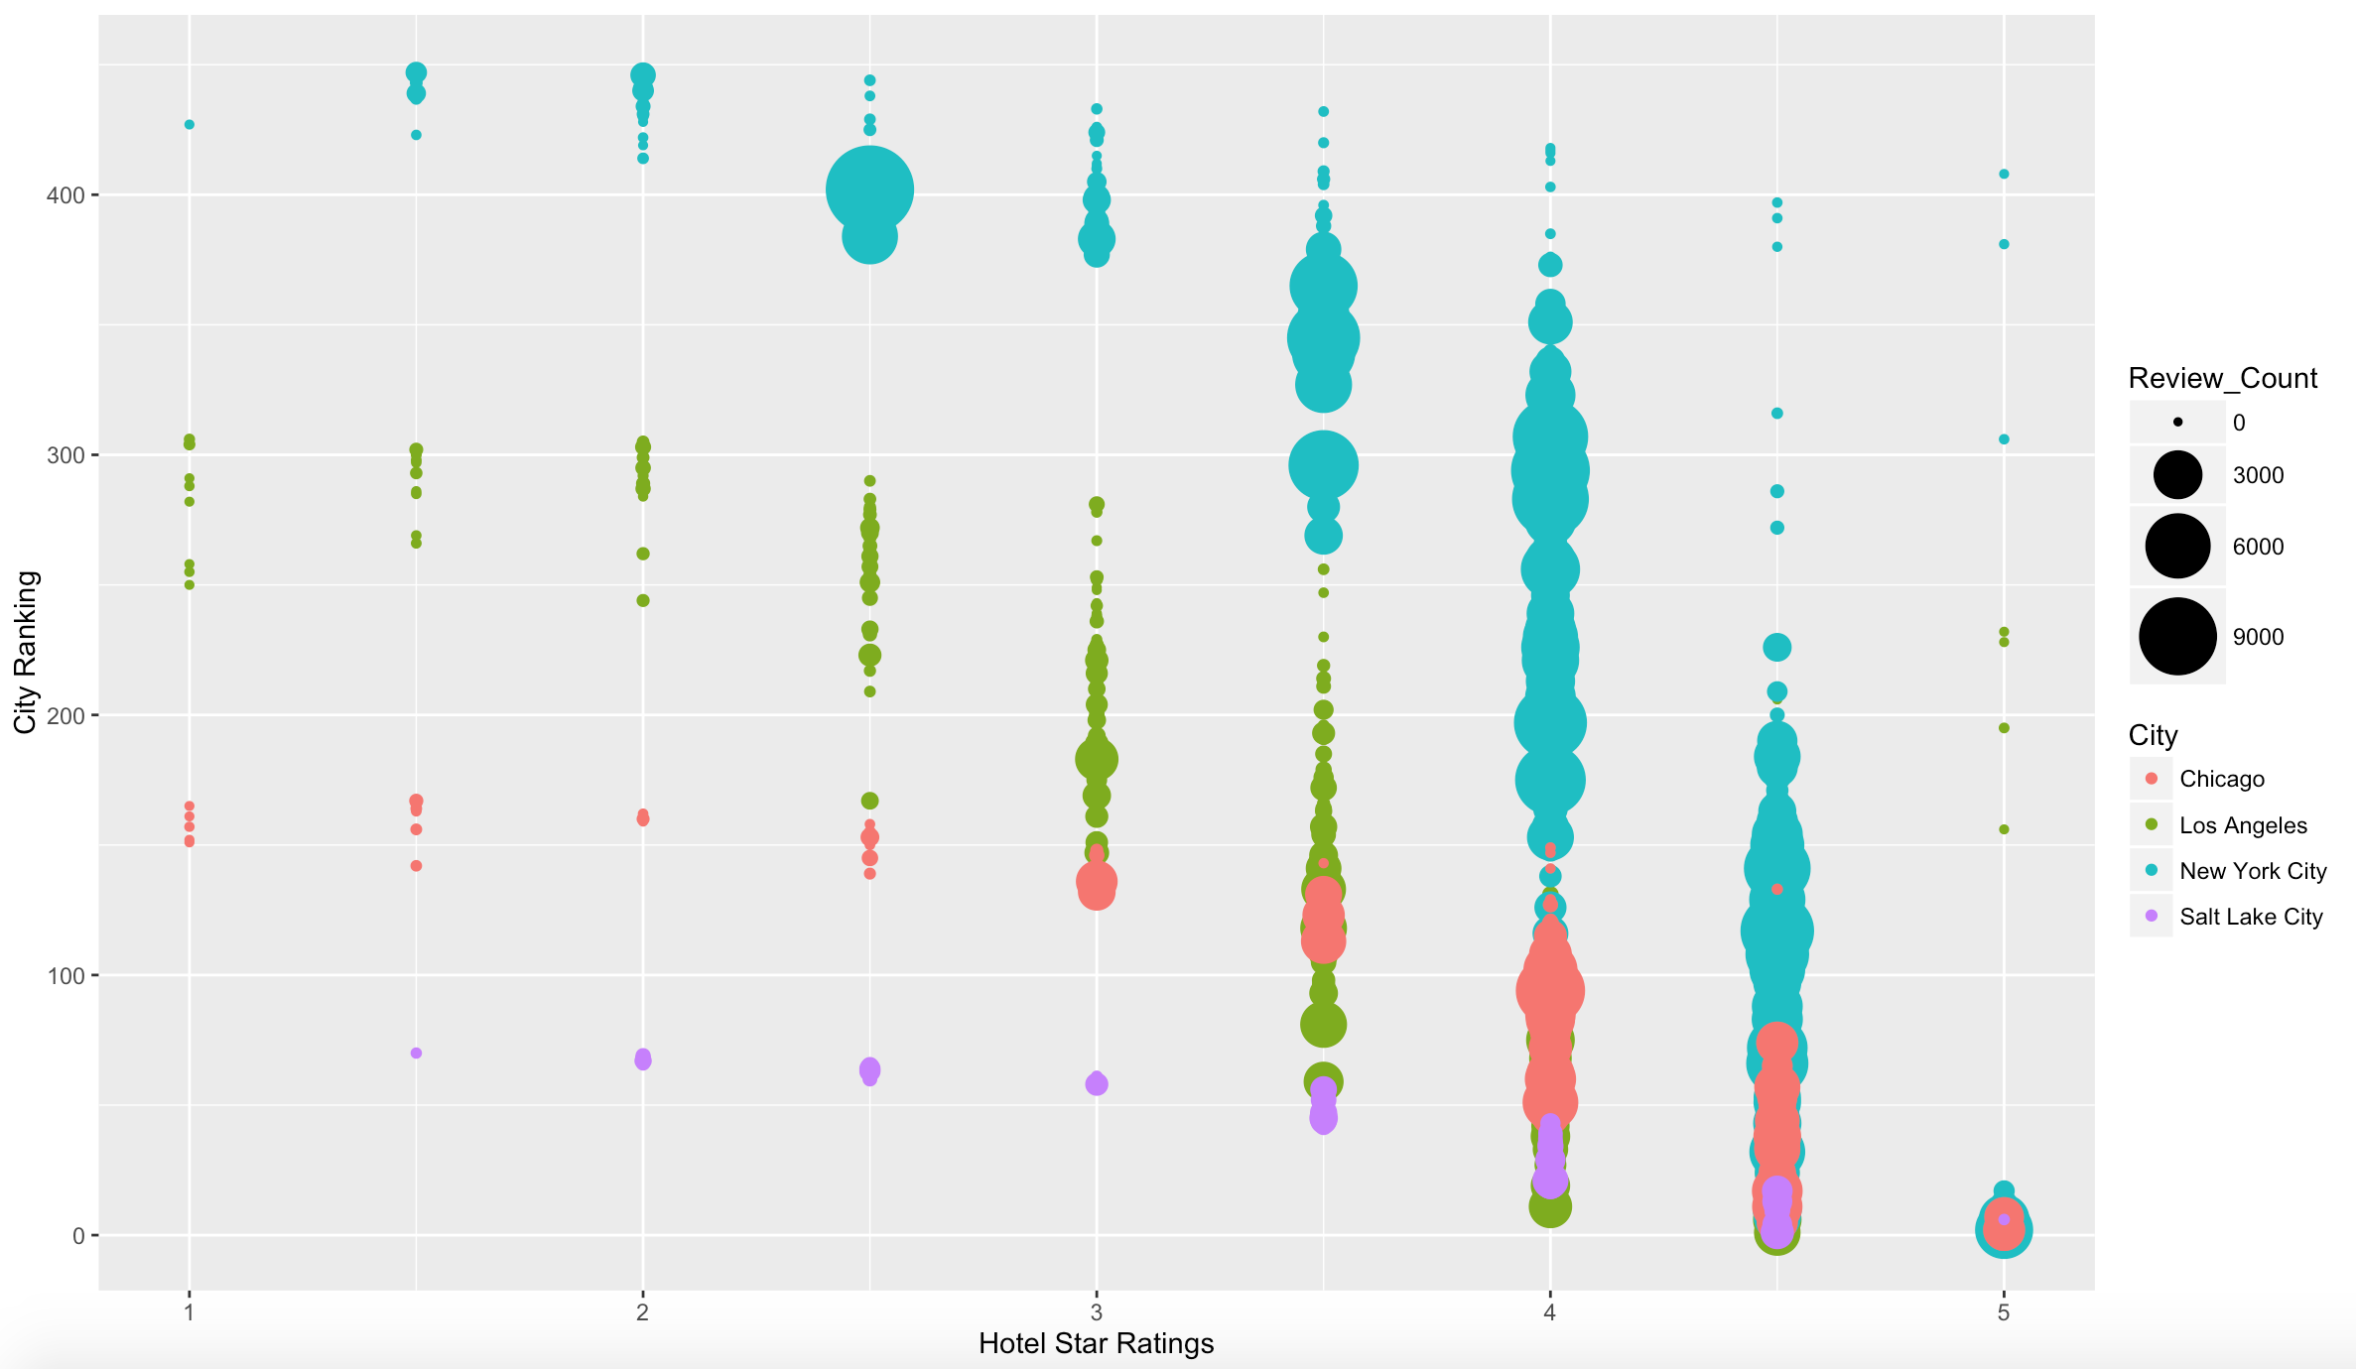
Hotel Ratings and City Reviews

Slide 15
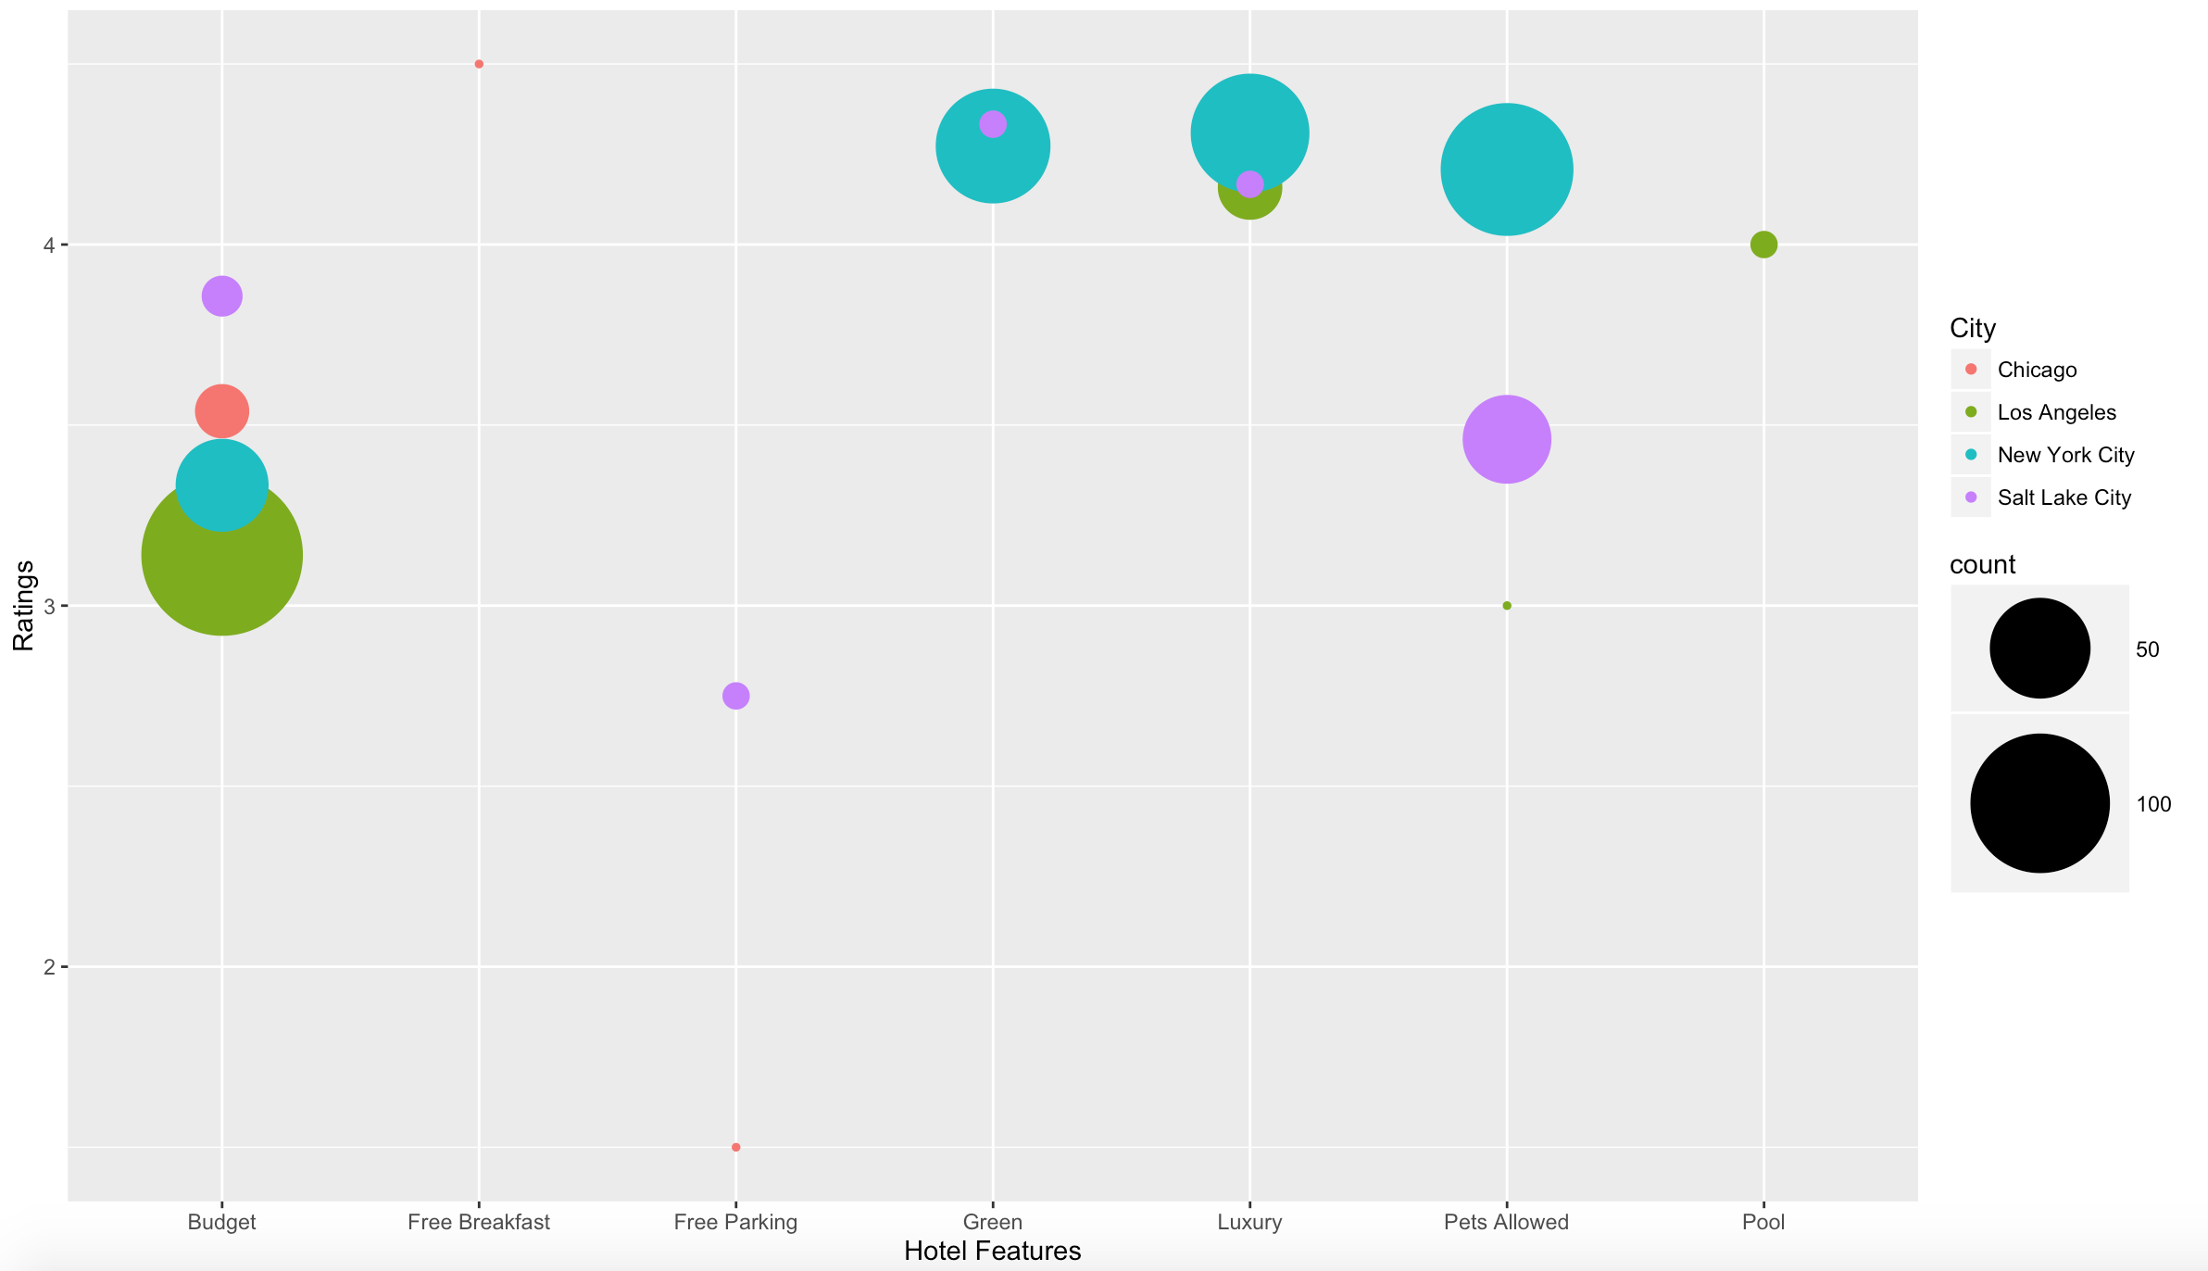
Hotel Ratings and Features

Slide 16
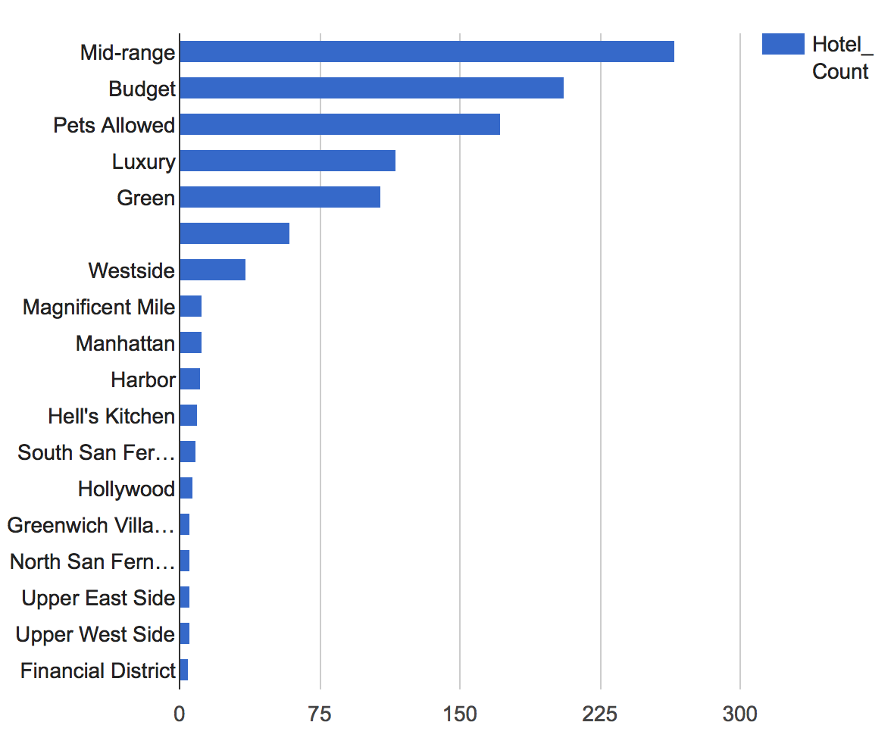
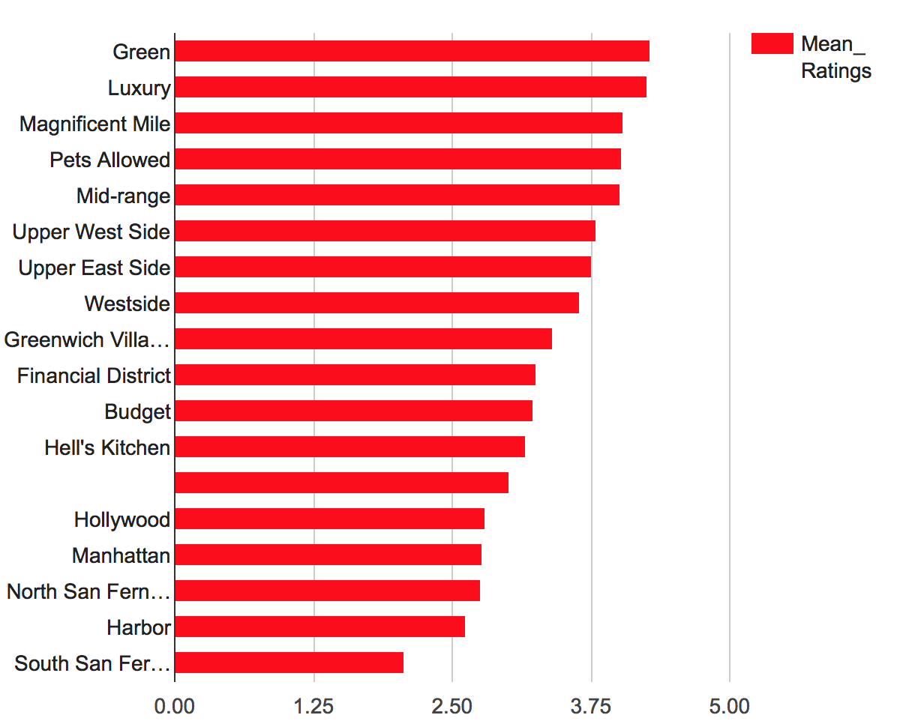
Hotel Feature Comparisons
Feature Count
Feature Ratings

Slide 17
Next Steps
Scrape all cities, prices, additional ad features, reviews
Estimate value of feature tags
NLP for corresponding reviews
Consider including “Things to Do”, “Restaurants”, and “Forums”
Incorporate into Shiny app for comparison to Priceline

Slide 18



I’d Like to Thank my Sponsors

